Slide 1

CYBERSECURITY ATTACKS
Exploratory Data Analysis (EDA)

Slide 2


Slide 3

What Is The Purpose:
The impact of cyberattacks all over the world has been increasing at a constant rate every year. Performing exploratory data analysis helps organizations to identify, manage, and safeguard the information that could be vulnerable to cyber-attacks

Slide 4
What Is The Approach :
The approach here is to state the use of Data Science in analyzing data and to provide a more detailed view of the most common cybersecurity attacks, and what are the most accessed logical ports, the visible patterns as well as the trends and occurrence of attacks.

Slide 5
DATA OVERVIEW:
The dataset was created and acquired by the IXIA PerfectStorm tool in the Cyber Range Lab of the AustralianCentre for Cyber Security (ACCS):
Attack category
Time
Source IP/Port
Protocol
Attack subcategory
Attack Name
Destination IP/Port

Slide 6
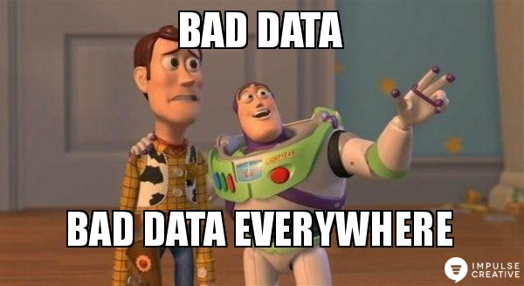

Slide 7
DATA CLEANING:
1421927414-1421927416
Start Time:
1421927414
END Time:
1421927416
2015-01-22 11:50:14
2015-01-22 11:50:16
Day ,Year , Month
Day ,Year , Month

Slide 8
DATA CLEANING:
Invalid Protocol Range
duplicated
01
02
03
04
Nulls
Upper & LOWER CASE

Slide 9
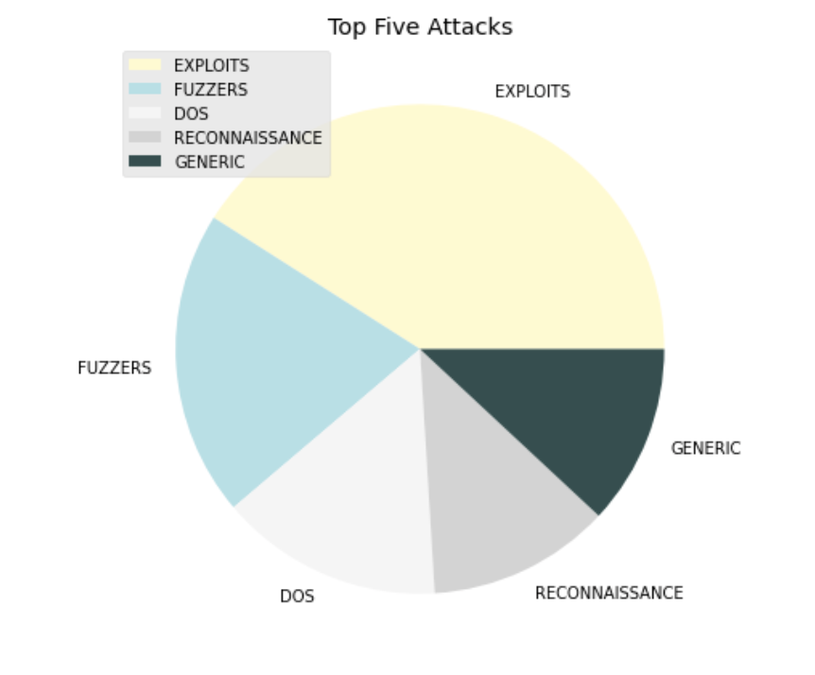
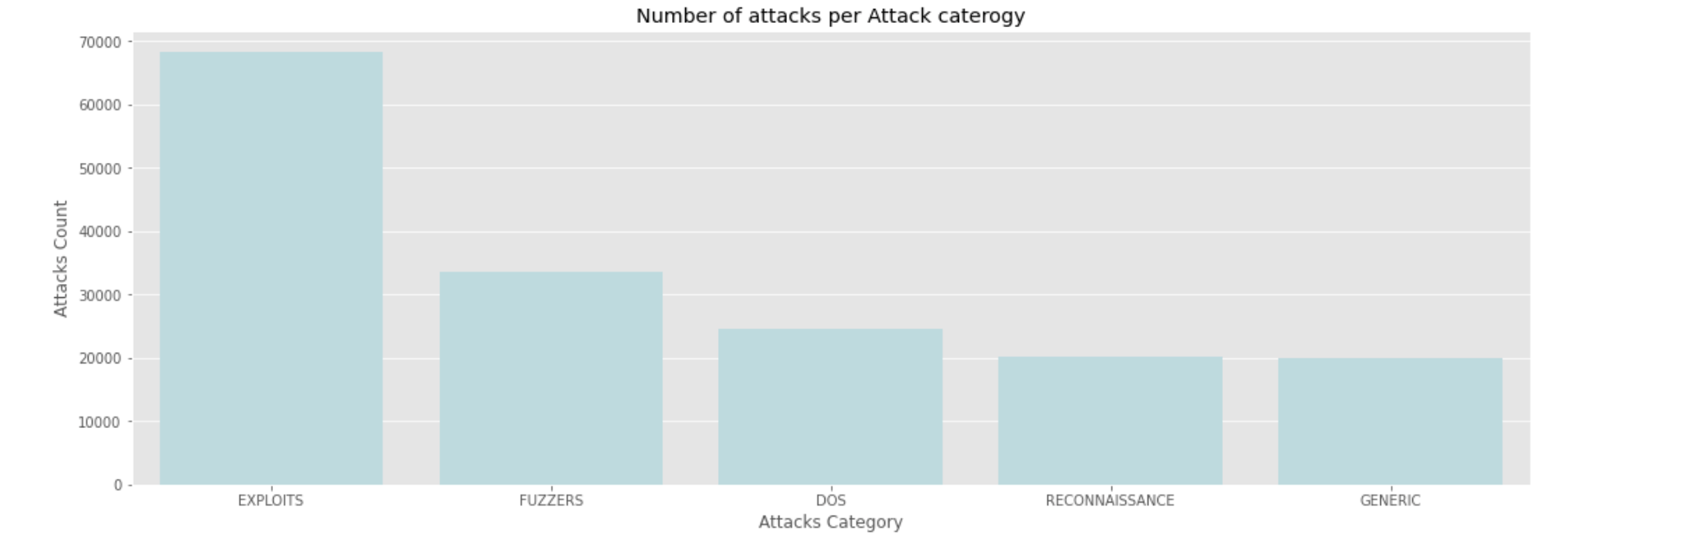
Top Five Attacks & Its Counts:

Slide 10
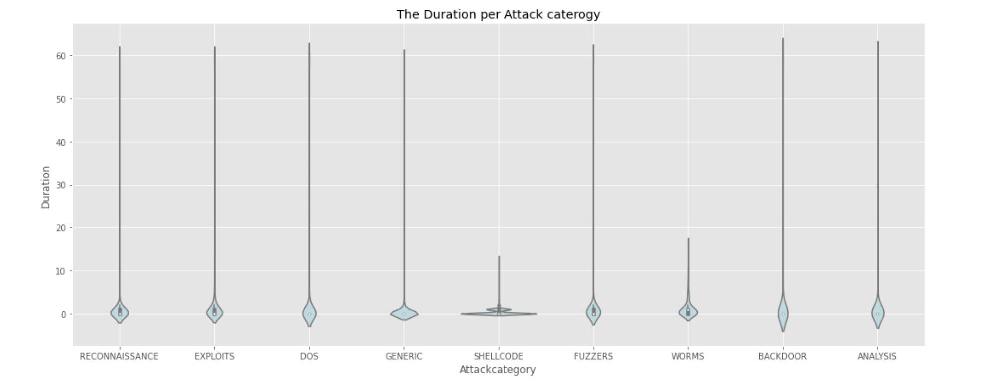
The Duration per Attack category:

Slide 11
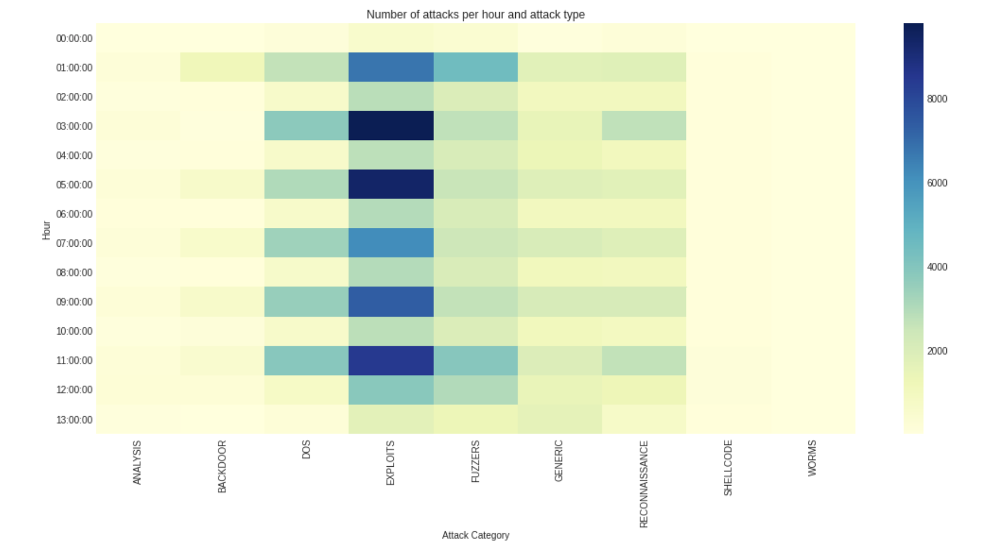
Number of attacks per hour and attack type:

Slide 12
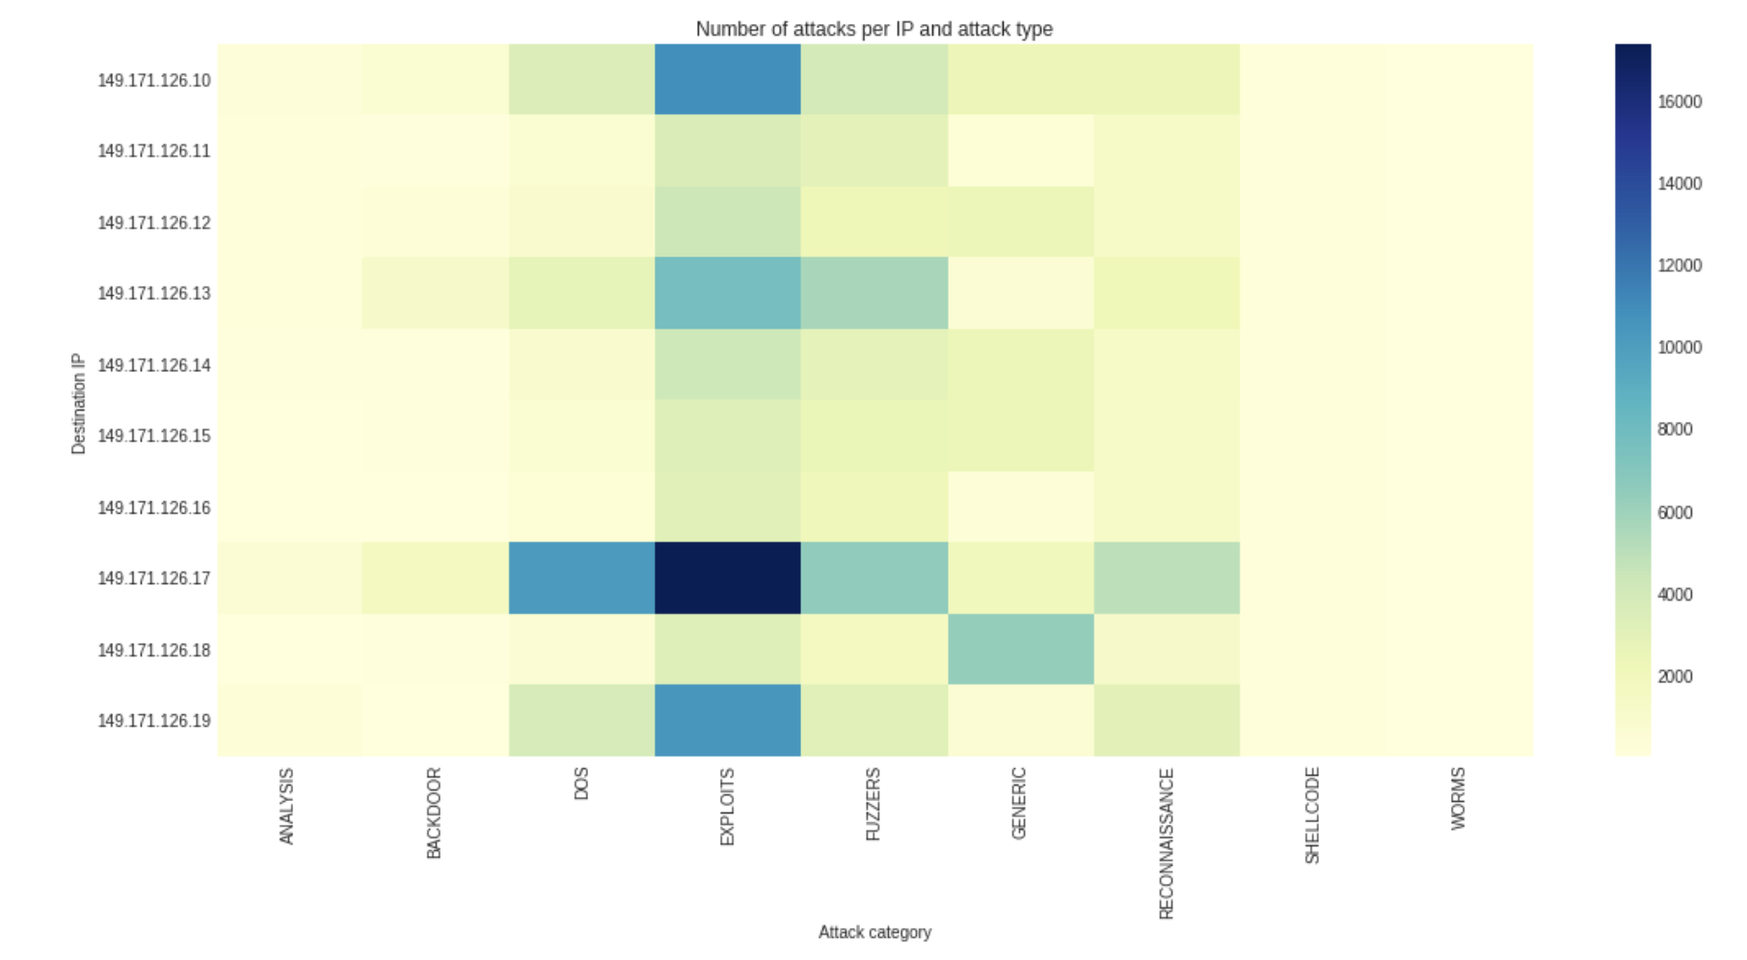
Number of attacks per IP and attack type:

Slide 13
In short nut :
The most common cybersecurity attacks
The duration per Attack category
Number of attacks per hour and attack type
Number of attacks per IP and attack type

Slide 14

THANK YOU

